Slide 1

The Sysops Squad Migration
Pentagram
Notes:
We are team Pentagram and we are very excited & appreciative for having this opportunity to share our Architecture proposal to make the world a better place. Through Penultimate Electronics, the Sysops Squad, and all of their customers & associates.
Let's jump right in...

Slide 2
Agenda
Background & The Journey
Motivation
The Problems & Our Guiding Principles
Artifacts for initial analysis
Our Approach
Narrowing Architectural Characteristics
Picking an Architectural Style
Two ways to do it
Trade-offs, Decisions & Consequences
The Migration
Architectural Components
Phase 1
Phase 2
Phase 3
Looking Ahead
Conclusion
Notes:
We will walk through
+ Background & The Journey
+ Motivation
+ The Problems & Our Guiding Principles
+ Artifacts for initial analysis
+ Our Approach
+ Narrowing Architectural Characteristics
+ Picking an Architectural Style
+ Two ways to do it
+ Tradeoffs, Decisions & Consequences
+ The Migration
+ Architectural Components
+ Phase 1
+ Phase 2
+ Phase 3
+ Looking Ahead
+ Conclusion

Slide 3
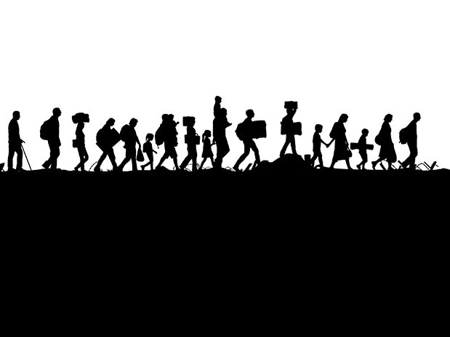
Background & The Journey
The measure of intelligence is the ability to change
~ Albert Einstein
Notes:
In the initial days, when Penultimate Electronics (and the Sysops Squad) were not too big, things were fine with the monolith. And then, Penultimate started to experience growth... Growth with fluctuations!

Slide 4
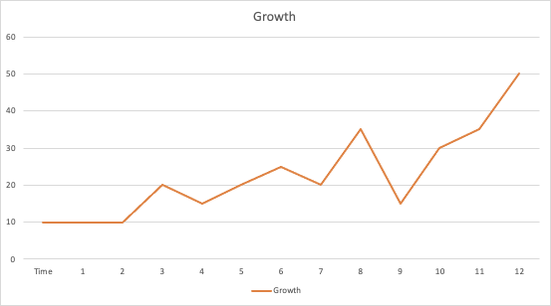
Motivation
How to accommodate growth with adaptive cost model?
Over provision
Growth with fluctuations
Steady growth
Under provision
Notes:
Growth comes with the challenge of fluctuation.
Fluctuation on the macro level, for example a support event that causes a surge in the number of equipments being purchased with support plan
Fluctuation on the micro level, for example peak hours for support calls.
Motivation: Why do we need a new architecture to accommodate the change?
The monolith was not created with growth in mind.
Adding more hardware does not solve the current problem, we will endup with having a parallel monolith.
The other extreme of creating many small modules will cause the sand grain problem and may not be a good immediate solution.
Let’s look at some artifacts we created to help analyze the system better…

Slide 5
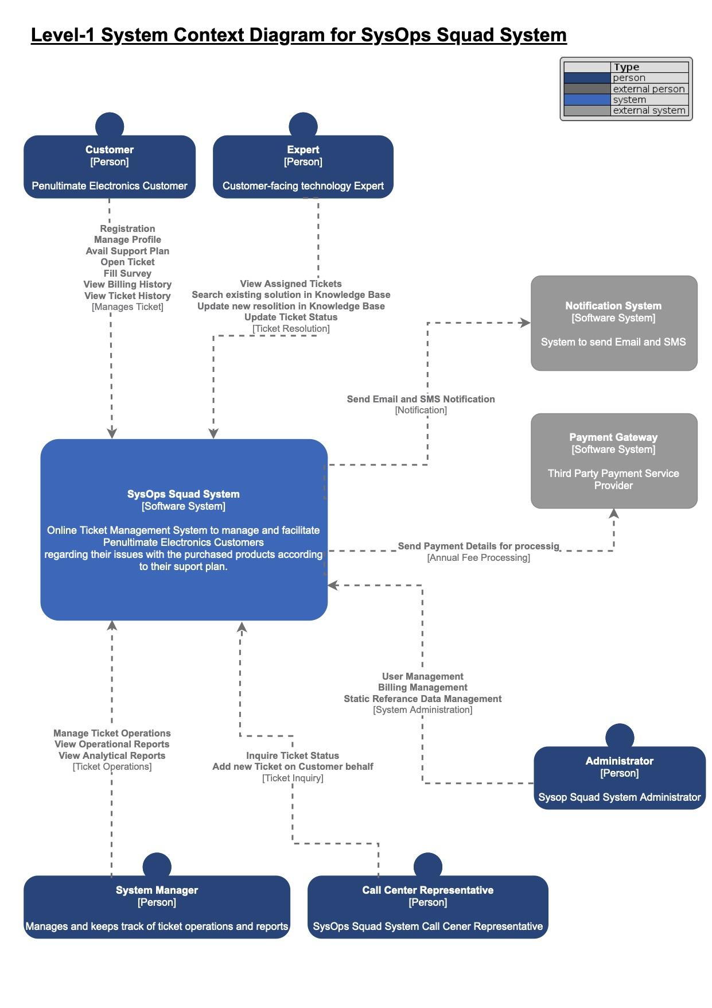
C4 System Context Diagram
Notes:
The C4 System Context provided us with a high level perspective of what we were dealing with

Slide 6
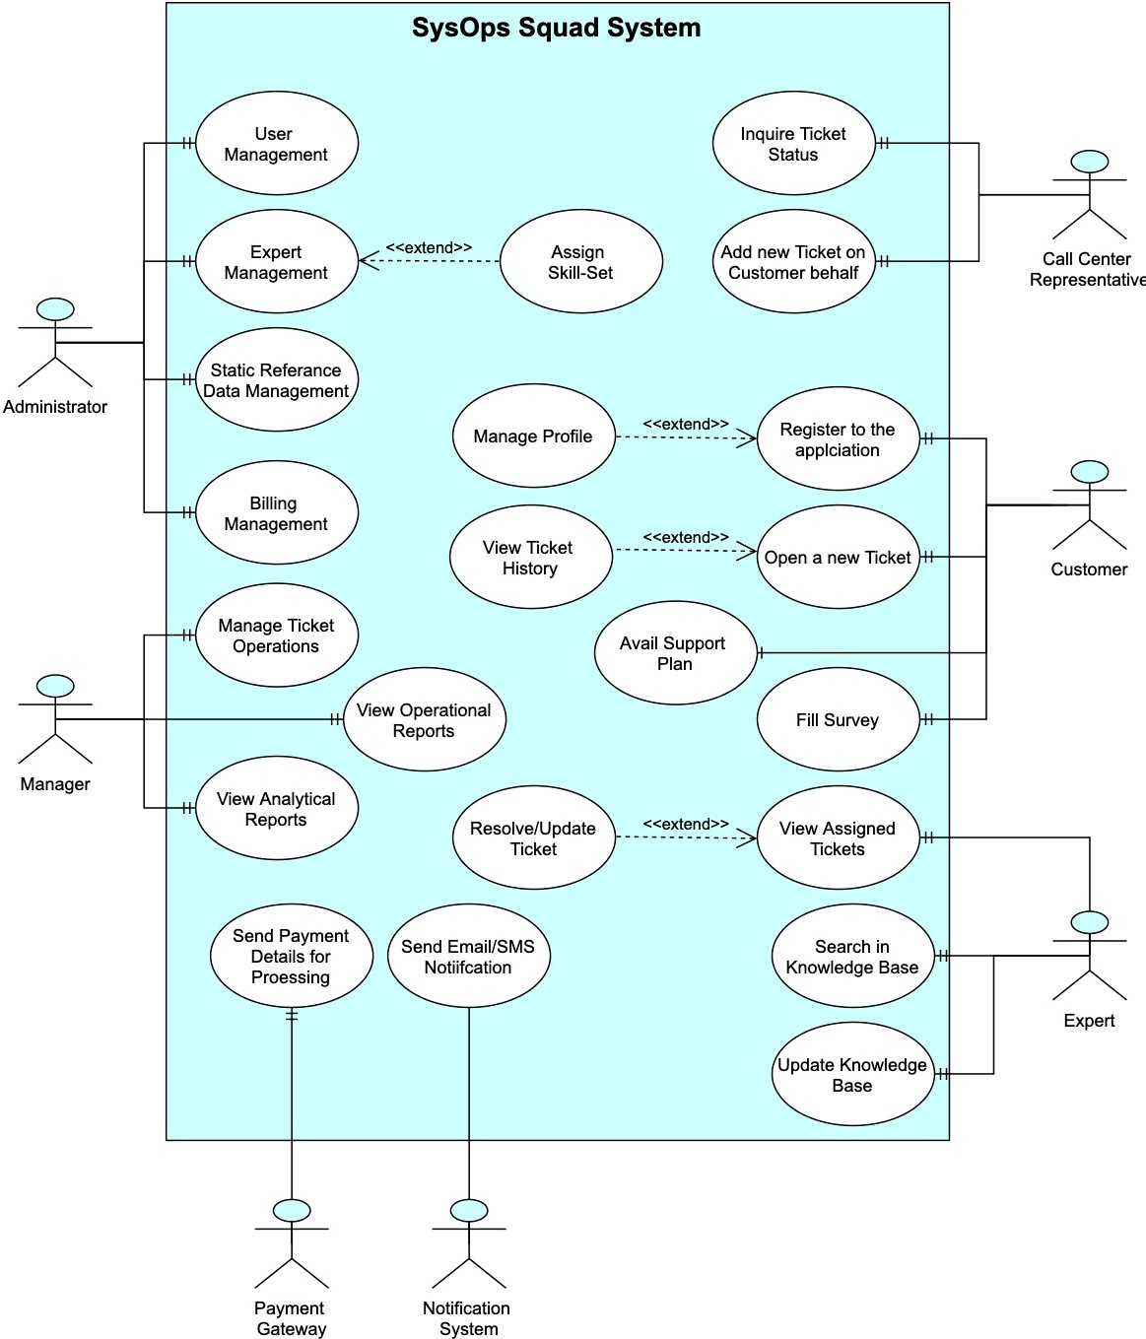
Use Case Diagram
Notes:
The Use Case diagram provided us with an overview of various ways in which the system could be accessed

Slide 7
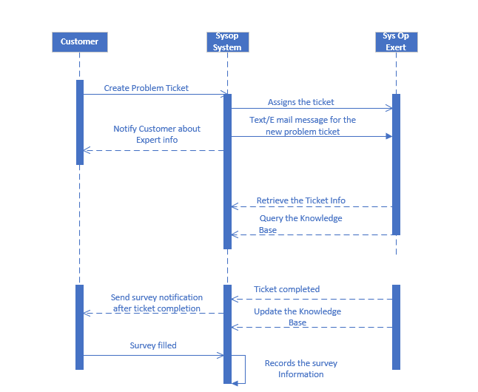
Sequence Diagram: Ticketing Workflow
Notes:
This is our favorite, because it provides us with a sense of time flowing through the system. And (in a poetic sort of way) brings the system alive for us.
Studying the sequence diagram led to -
Behavior analysis of the system (during runtime)
Understanding of the runtime interactions of different users with the system
Helping us determine what parts of the system needed to have Synchronous vs Asynchronous communication.

Slide 8
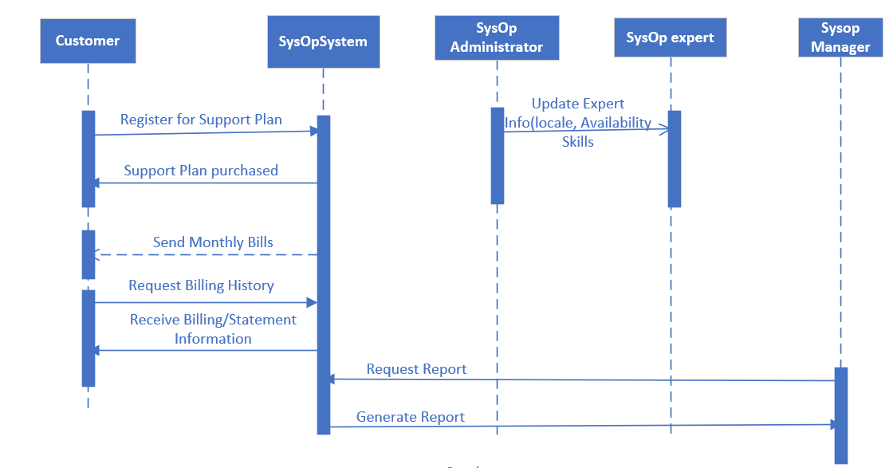
Sequence Diagram: Non-Ticketing Workflow
Notes:
… And the same is true for the Non-Ticketing Workflow!

Slide 9
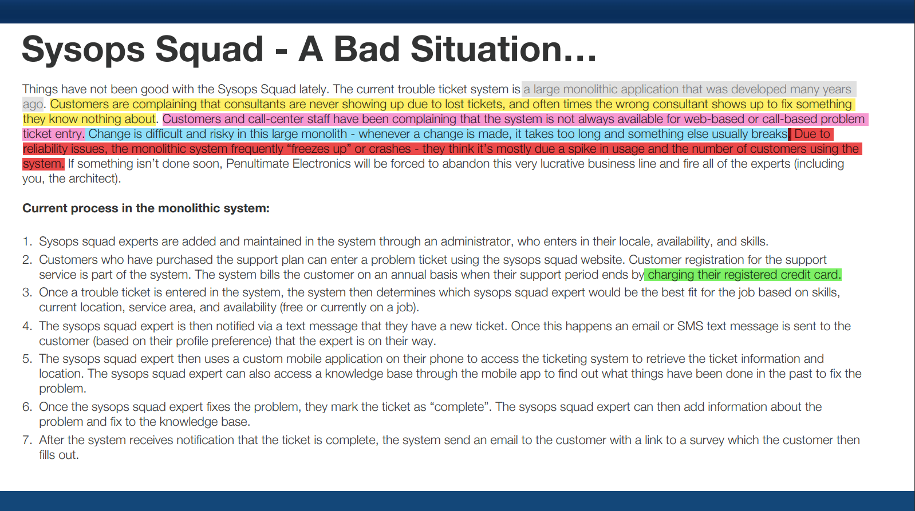
The Problems & Our Guiding Principles
We NEVER ever want to be in this situation again
Excellent customer experience should be a driver for future business growth
Notes:
Have any of you come home with a bad progress report and had to face your parents with a knot in your stomachs. Well… some of us have had to do it!
And that’s the feeling we got when we looked at these various colored marks telling us all the areas we needed to improve.
And there’s a feeling deep down that guides us to make some resolutions for next time…
<click>
One, “We NEVER ever want to be in this situation again”, i.e. a few years down the road people should not talk of this re-architecture effort as “a large monolith application that was developed years ago”
And Two, “I will make my Mama proud”, and in our context this translates to “Excellent customer experience should be a driver for future business growth”

Slide 10

Our Approach
All great changes are preceded by chaos.
~ Deepak Chopra
Notes:
Let’s discuss the approach we took to keep to our resolution

Slide 11
Our Approach
… And Associated Challenges...
Identify gaps in architectural characteristics
Feasibility
Evolvability
Overwhelming
Deployability
Availability
Agility
Workflow
Elasticity
Fault Tolerance
Maintainability
Security
Data Integrity
Testability
Recoverability
Notes:
<say a quick one-liner about each characteristic as it pops up & if possible, why we need it>
Overwhelming isn’t it!!
We had to pick the most important ones and figured that not all parts of the system needed all of them together. It also gave us an idea of focusing on specific characteristics for specific parts of the system.

Slide 12
Our Approach
… And Associated Challenges...
Determine existing architectural patterns that will help address these gaps
Notes:
Using a tool available at DeveloperToArchitect.com, we mapped out our options. <click>
And came to realize that we needed a hybrid approach of building an “Event-driven” “Microservices” architecture. BUT, it came with a caveat…
<click>
The strength of some of our characteristics in the Microservice architecture was reduced, and over-ridden by the corresponding strength in the Event-driven architecture.
This was a tradeoff we had to make to use a hybrid approach.

Slide 13
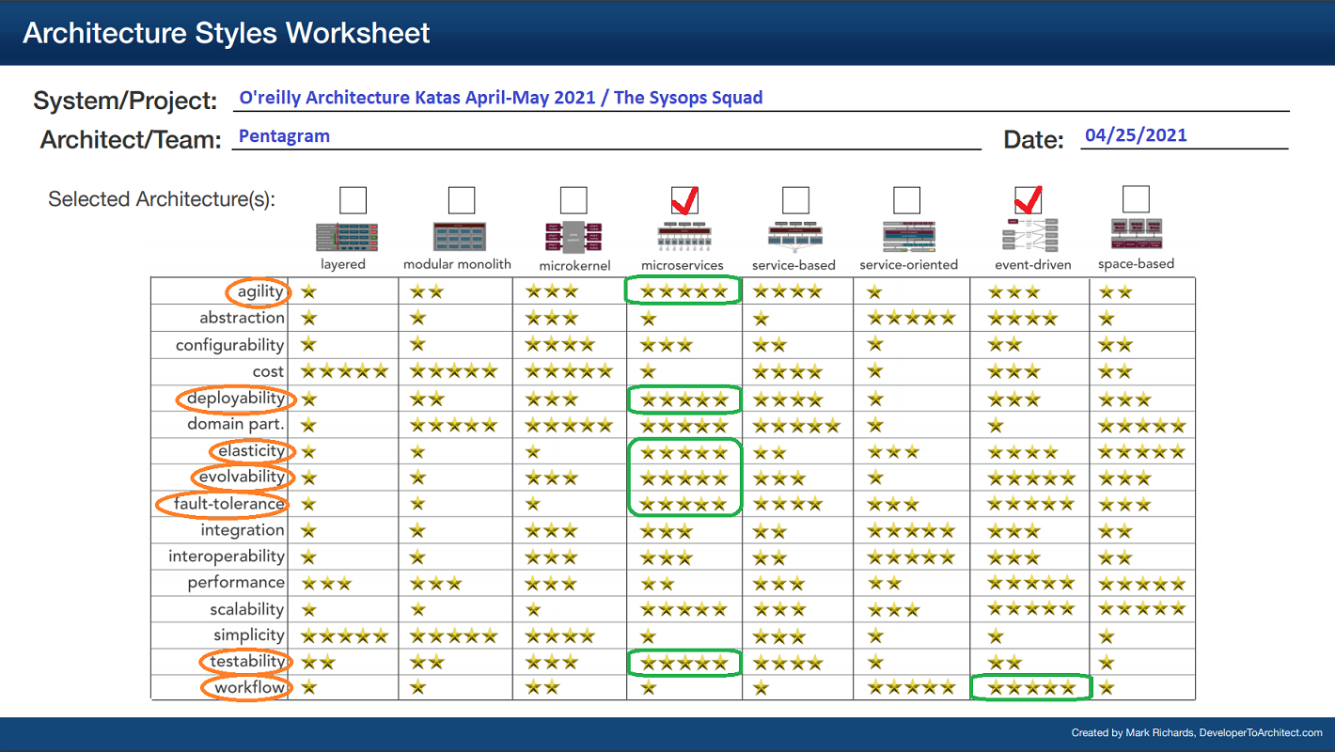
Our Approach
… And Associated Challenges...
Determine existing architectural patterns that will help address these gaps
Notes:
<click>
And came to realize that we needed a hybrid approach of building an “Event-driven” “Microservices” architecture. BUT, it came with a caveat…
<click>
The strength of some of our characteristics in the Microservice architecture was reduced, and over-ridden by the corresponding strength in the Event-driven architecture.
This was a tradeoff we had to make to use a hybrid approach.

Slide 14
Our Approach
… And Associated Challenges...
Define a path from existing system to the utopian world
A BIG BANG Approach
A Slow, But Steady Approach
Pros:
Faster results
Pros:
Low Risk
Ability to include micro-tweaks & adjustments along the way
Team gets more room for adapting to the new architecture
Cons:
High Risk
Steep Learning Curve
High Complexity
Cons:
Slower results
Additional work in determining and picking the right fitness functions
Notes:
We had two options here…
<click>
First, was a “Big Bang” approach that (as the name suggests) deemed us to jump into the deep end with both feet and learn to swim as we go
The obvious advantage to that was… <click>
Seeing Faster Results
And the downsides… <click>
High Risk
Steep Learning Curve
High Complexity
<click>
Second, was a “Slow, But Steady” approach that would have us use a thermometer to test the waters before making a move - a more data driven approach
The obvious advantage to that was… <click>
Low Risk
Micro-tweaks (if that’s not a word… well, now it is)
Easier learning curve for team... And the organization (that by Conways law must presently look like the monolith we have)
The flip-side to this though is… <click>
We will not see instant results
There is additional work in figuring out the right fitness functions

Slide 15


Trade Offs, Decisions and Consequences
Strict Contracts
Value based Contracts
Better control
Brittle Architecture Coupling
Fitness functions
Loose Coupling
Orchestration
Choreography
Centralized Workflow
Better control of sagas and error handling
Distributed Workflow
Complex saga and error handling
Notes:
We had quite a few decisions to make and for brevity, we will discuss two of them today
<click>
“Strict Contracts” vs “Value Based Contracts” between our services
<click>
With Strict Contracts, we get better control and tighter coupling
<click>
Value based contracts are data driven & governed by fitness functions with loose coupling
<click>
We picked “Value based contracts” because we want the flexibility of loose coupling & the power of fitness functions
<click>
We had to pick between “Orchestration” vs “Choreography” for our Event Driven Architecture
<click>
With “Orchestration”, we would get a Centralized Workflow capability and better control
<click>
With “Choreography”, our workflow would be distributed and not need an additional entity for orchestration. But it also makes saga replay & error handling a little more tricky.
And the winner issss….
<click>
“Orchestration” - we picked this because we really wanted to track our workflows (for lost tickets)

Slide 16

The Migration
To improve is to change; to be perfect is to change often.
~ Winston Churchill
Notes:
Let us now walk down our yellow brick road to The Best Sysops Squad architecture you’ll see today

Slide 17
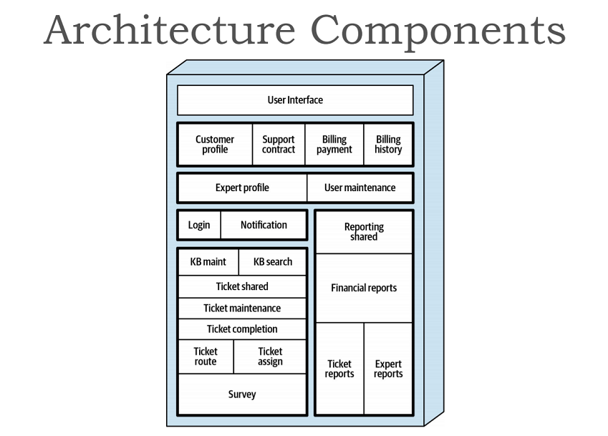
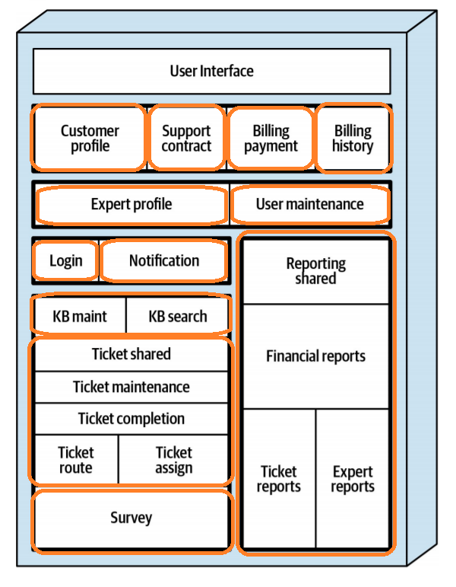
Notes:
Our first step from where we are at is to identify like components that can be grouped together to create coarse grained service boundaries
<click>
We also need to define fitness functions for characteristics that we need to track. This is so we can draw out a baseline for our system against which we can measure & track progress in subsequent phases.

Slide 18
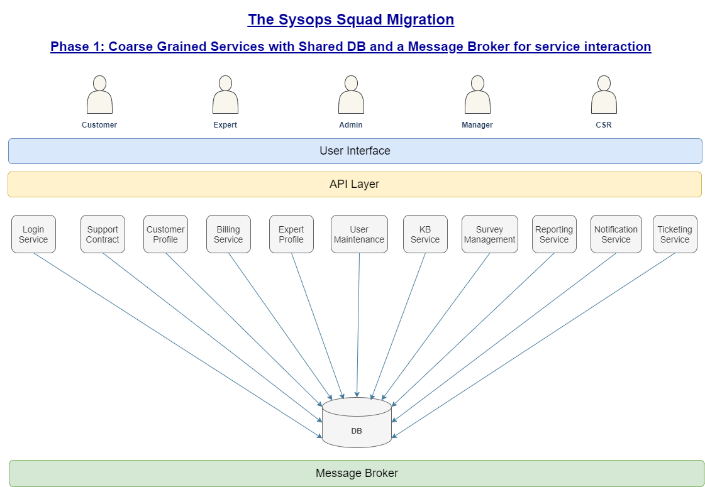
Notes:
In the spirit of making incremental changes (as against the Big Bang approach), we bundled the previously identified components in coarse grained services sharing a common DB.
Besides giving the development and operations team some breathing room, this allows services to be managed independently.
We also introduced a Message Broker for interservice communication (which was previously done using object references)
While it is a significant step from the monolith we previously had, there is still a constraint of the shared DB that limits services from making structural changes to the data model without impacting other services.
Let’s see how we can improve on this...

Slide 19
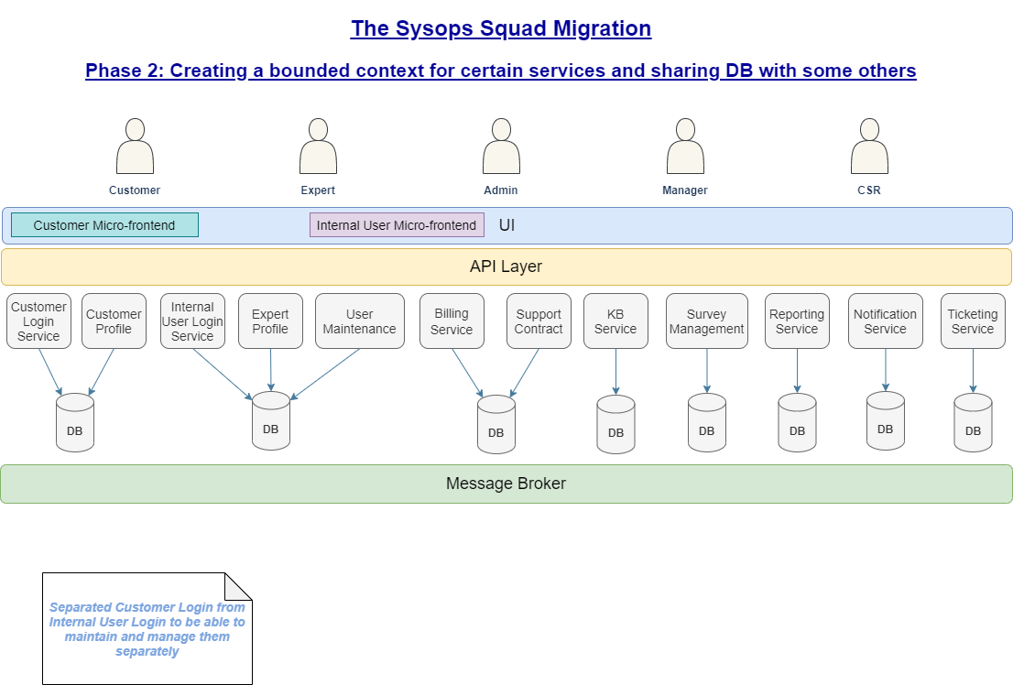
Notes:
Another significant step towards a better world for Sysops Squad and it’s customers is here, wherein we have (pragmatically) broken down the data model to exclusively serve specific services viz create a bounded context for services.
Places where the DB is shared, is where we identified significant business domain coupling between services.
Another significant change in this phase is the separation of the Login Service into “Customer Login Service” & “Internal User Login Service” - we found that there are significant advantages of separating out Customer Login and treat it “special” (we have documented this in much detail in adr_005-00.

Slide 20
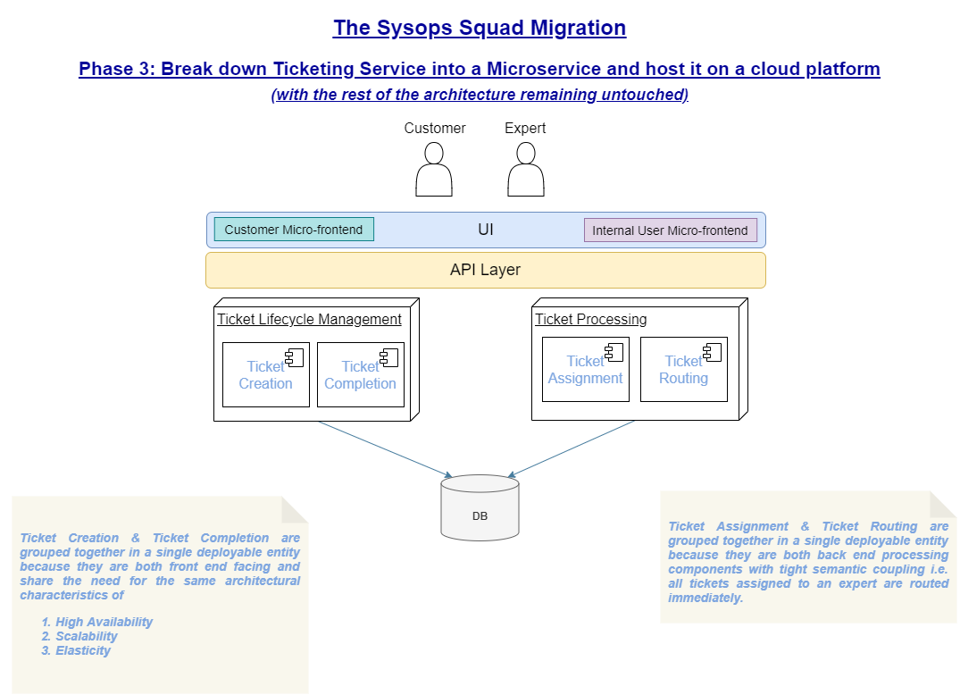
Notes:
With the rest of the system staying untouched from Phase 2, we turn our focus and zoom into the Ticketing Service, to be decomposed into a set of finer grained microservices.
The reason we picked this particular service for change is because (in our opinion) it needs to be highly available, recoverable, agile, scalable, reliable and elastic, more than any other service. We have elaborated this decision in adr_007-00.
In this phase, we also move the ticketing service to the cloud, to leverage some inherent characteristics that the cloud can provide and are in line with our requirements for this service as well.

Slide 21
Looking Ahead: System Architecture
Based on data obtained from fitness functions, other services can be converted to microservices as well and moved to the cloud.
Potential candidates for a first draft pick are -
Login Service
Billing Service
Notes:
With the learnings from Phase 3 and data gathered & analysed from fitness functions, we recommend moving other services over to microservices and the cloud.
<click>
Based on our current understanding potential candidates are the “Login Service” and the “Billing Service”.

Slide 22
Looking Ahead: Suggestions To Business
Leverage data collected in the KB to create a data lake that can be used to drive business growth
Provide self service options to customers for simple tickets
Bots
Online Help
Train & Empower CSRs to address common issues over the phone (to free up time for Experts to address only critical/complicated issues)
Assign Experts only for issues not addressed by the previous two (eliminates backlog of tickets)
Notes:
Leveraging the KB and building a data lake for analytics can have significant business impacts
<click>
Customer Self Service (will also instill a sense of pride among customers for having fixed their own gadget
<click>
Empowering CSRs
<click>
Using Experts judiciously

Slide 23
Conclusion
Transition (over time) to...
Fully Data Driven approach to changes
Hybrid, Evolutionary architecture
Use Fitness Functions to drive changes
Agile processes
AI, BI & Data Analytics
Notes:
To summarize our proposal, we would like the current architecture to transition (over time) to have… <click>
Fully Data Driven approach to changes <click>
Hybrid, Evolutionary architecture <click>
Use Fitness Functions to drive changes <click>
Agile processes <click>
AI, BI & Data Analytics

Slide 24
It is not the strongest of the species that survive, nor the most intelligent, but the one most responsive to change.
Charles Darwin
Notes:
<just read the quote from the slide>

Slide 25

Q & A
Ask and Ye Shall Receive…*
* For premium members only whose Sysops Squad subscription is currently active and bills paid in full
Notes:
Thank You Everyone for your time and patience. We would love to answer any questions you may have now.

Slide 26

System Context Diagram / C4-Container Diagram
Ali Imran
“Make it simple, but significant.” –Don Draper

Slide 27
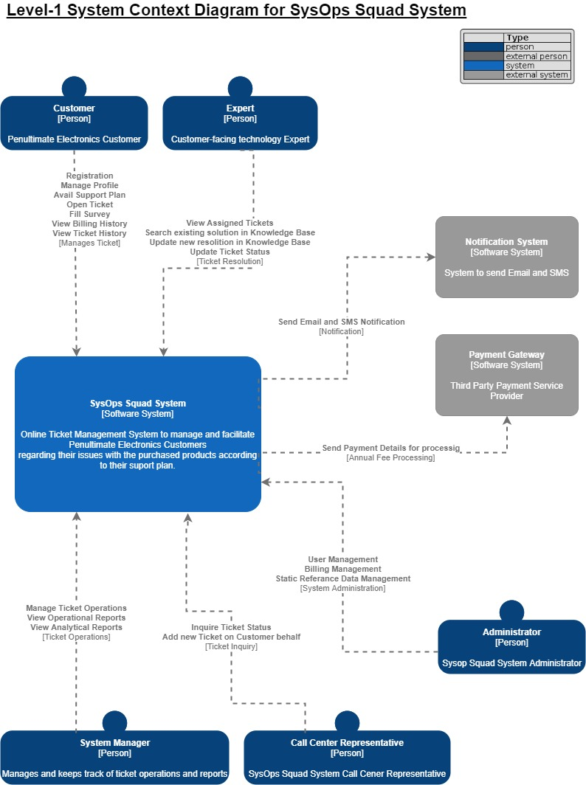

Slide 28
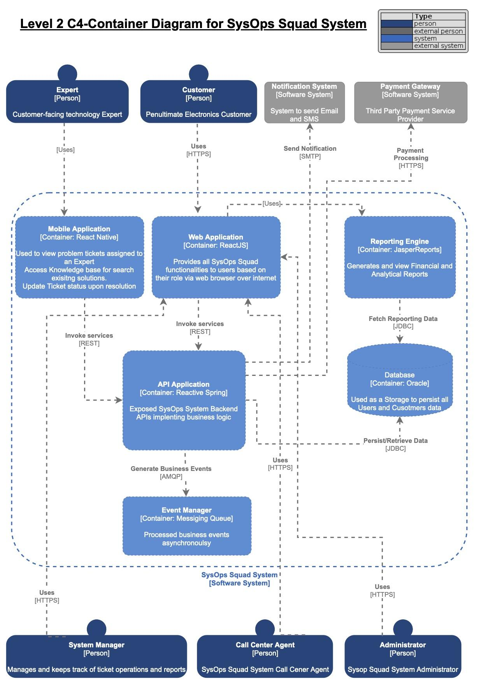

Slide 29
Phase1: (Application Decomposition)
Architecture Choice and Guidelines :
Application Decomposition - coarse grained services.
Database Decomposition - Single Monolithic database.
Message Broker - Better centralized workflow
API Layer- Hiding Database structures from Users.
User Interface- A single user Interface for different system users

Slide 30
Phase2: (Database Decomposition)
Architecture Choice and Guidelines :
Database Decomposition - Bounded Context of services with own DBs.
User Interface: Two different micro front ends for customer and internal user

Slide 31
Phase 3: Microservice Deployment
Architecture Choice and Guidelines
Ticketing Service- Break Down to Microservice.

